Slide 1
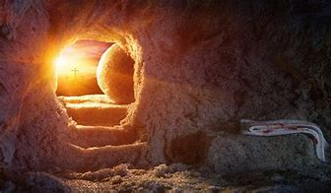
He Is Risen

Slide 2
Luke 24:1-12
24:1 Now upon the first day of the week, very early in the morning, they came unto the sepulchre, bringing the spices which they had prepared, and certain others with them.2 And they found the stone rolled away from the sepulchre.3 And they entered in, and found not the body of the Lord Jesus.4 And it came to pass, as they were much perplexed thereabout, behold, two men stood by them in shining garments:

Slide 3
Luke 24:1-12
5 And as they were afraid, and bowed down their faces to the earth, they said unto them, Why seek ye the living among the dead?6 He is not here, but is risen: remember how he spake unto you when he was yet in Galilee,7 Saying, The Son of man must be delivered into the hands of sinful men, and be crucified, and the third day rise again.8 And they remembered his words,

Slide 4
Luke 24:1-12
9 And returned from the sepulchre, and told all these things unto the eleven, and to all the rest.10 It was Mary Magdalene, and Joanna, and Mary the mother of James, and other women that were with them, which told these things unto the apostles.11 And their words seemed to them as idle tales, and they believed them not.

Slide 5
Luke 24:1-12
12 Then arose Peter, and ran unto the sepulchre; and stooping down, he beheld the linen clothes laid by themselves, and departed, wondering in himself at that which was come to pass.

Slide 6
He Is Risen
Arrival at the tomb
Departure from the tomb

Slide 7
He Is Risen
Arrival at the tomb
  finding
    no stone
    no body
  fear
  folly Mark 12:27
  forgetfulness

Slide 8
He Is Risen
Departure from the tomb
  remembrance John 2:22
  recounter
  retinue
  reluctant John 20:8

Slide 9
Cornerstone Bible Church
A Church desiring to help people find
their purpose in life, expanding God’s
kingdom through ministry

