Slide 1
All Ashore
Cornerstone Bible Church
Pastor Duane Acree
6-14-2020

Slide 2
Acts 28:1-10
1 And when they were escaped, then they knew that the island was called Melita.2 And the barbarous people shewed us no little kindness: for they kindled a fire, and received us every one, because of the present rain, and because of the cold.3 And when Paul had gathered a bundle of sticks, and laid them on the fire, there came a viper out of the heat, and fastened on his hand.4 And when the barbarians saw the venomous beast hang on his hand, they said among themselves,

Slide 3
Acts 28:1-10
No doubt this man is a murderer, whom, though he hath escaped the sea, yet vengeance suffereth not to live.5 And he shook off the beast into the fire, and felt no harm.6 Howbeit they looked when he should have swollen, or fallen down dead suddenly: but after they had looked a great while, and saw no harm come to him, they changed their minds, and said that he was a god.7 In the same quarters were possessions of the chief man of the island, whose name was Publius; who received us, and lodged us three days courteously.8 And it came to pass,

Slide 4
Acts 28:1-10
that the father of Publius lay sick of a fever and of a bloody flux: to whom Paul entered in, and prayed, and laid his hands on him, and healed him.9 So when this was done, others also, which had diseases in the island, came, and were healed:10 Who also honoured us with many honours; and when we departed, they laded us with such things as were necessary.

Slide 5
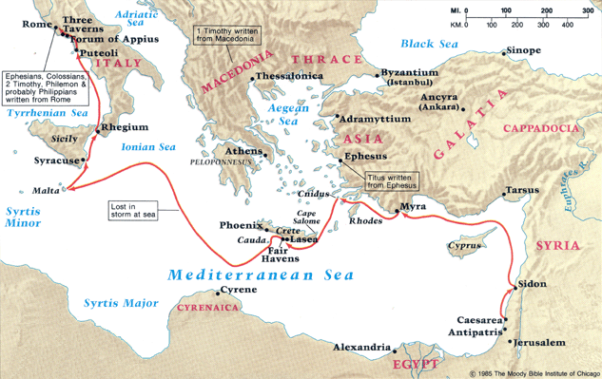

Slide 6
All Ashore
  Certain island
  Certain people
  Certain miracles

Slide 7
All Ashore
  Certain island
    safe (27:26)
    Melita (refuge)
    Malta
    17ml x 9 1/4mw
    Salmoneta

Slide 8
All Ashore
  Certain people
    barbarous Romans 1:14
    benevolent
    religious
    hospitable
    courteous

Slide 9
All Ashore
  Certain miracles
    27:22
    27:26
    Paul / viper Mark 16:16-18
    father / fever
    diseases /healed

Slide 10
Cornerstone Bible Church
A Church desiring to help people find their purpose in life, expanding God’s kingdom through ministry

