Slide 1
Last Leg
Cornerstone Bible Church
Pastor Duane Acree
7-12-2020

Slide 2
Acts 28:11-16
11 And after three months we departed in a ship of Alexandria, which had wintered in the isle, whose sign was Castor and Pollux.12 And landing at Syracuse, we tarried there three days.13 And from thence we fetched a compass, and came to Rhegium: and after one day the south wind blew, and we came the next day to Puteoli:

Slide 3
Acts 28:11-16
14 Where we found brethren, and were desired to tarry with them seven days: and so we went toward Rome.15 And from thence, when the brethren heard of us, they came to meet us as far as Appii forum, and The three taverns: whom when Paul saw, he thanked God, and took courage. Puteoli:16 And when we came to Rome, the centurion delivered the prisoners to the captain of the guard: but Paul was suffered to dwell by himself with a soldier that kept him.

Slide 4
Last Leg
  Bon Voyage
  Brethren
  Bondsman

Slide 5
Last Leg
  Certain island
    Melita (refuge)
    Malta
    17ml x 9 1/4mw

Slide 6
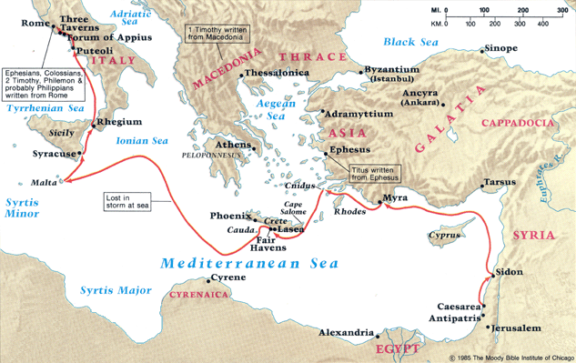

Slide 7
Last Leg
  Bon Voyage
    three months
    Castor & Pollux Isaiah 45:20
    Syracuse
    fetched a compass
    Rhegium
    Puteoli

Slide 8
Last Leg
  Brethren
    Acts 2:10
    Appius market app 50 miles
    The three taverns Psalm 119:63
    encouragement Joshua 1:6-7

Slide 9
Last Leg
  Bondsman
    arrival Acts 19:21; 23:11
    Julius
    allowed
    house arrest

Slide 10
Cornerstone Bible Church
A Church desiring to help people find their purpose in life, expanding God’s kingdom through ministry

