Slide 1
Welcome to Thessalonica
Cornerstone Bible Church
Pastor Duane Acree
08-16-2020

Slide 2
I Thessalonians 1:1-4
1 Paul, and Silvanus, and Timotheus, unto the church of the Thessalonians which is in God the Father and in the Lord Jesus Christ: Grace be unto you, and peace, from God our Father, and the Lord Jesus Christ.2 We give thanks to God always for you all, making mention of you in our prayers;3 Remembering without ceasing your work of faith, and labour of love, and patience of hope in our Lord Jesus Christ, in the sight of God and our Father;4 Knowing, brethren beloved, your election of God.

Slide 3
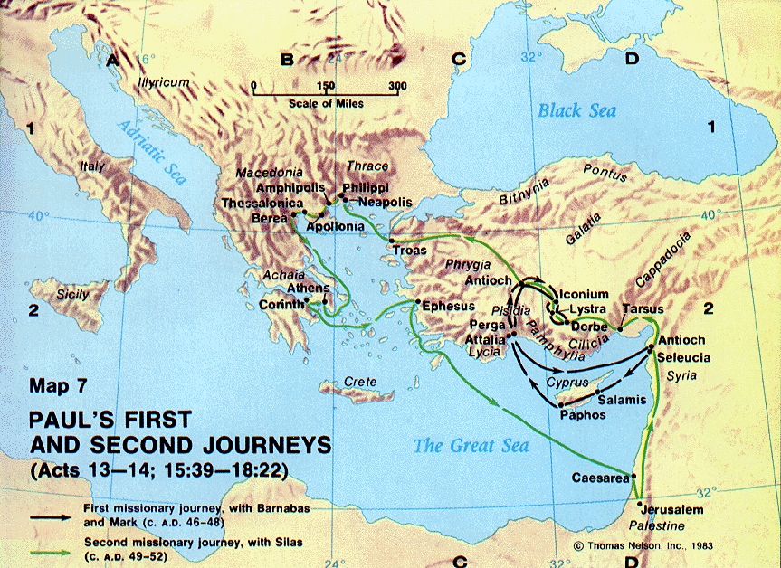

Slide 4
Welcome to Thessalonica
Cast
Church
Christian
Chosen

Slide 5
Welcome to Thessalonica
Cast
  Paul
  Silas
  Timothy

Slide 6
Welcome to Thessalonica
Church
  of the Thessalonians
  in God the Father
  in the Lord Jesus Christ
    grace and peace extended
    gratitude

Slide 7
Welcome to Thessalonica
Christian
  work of faith John 6:29
  labor of love John 14:15
  patience of hope Romans 8:24-25

Slide 8
Welcome to Thessalonica
Chosen
  knowledge
  brethren
  election

Slide 9
Cornerstone Bible Church
A Church desiring to help people find their purpose in life, expanding God’s kingdom through ministry.

