Slide 1
Rise Up
Cornerstone Bible Church
Pastor Duane Acree
11-1-2020

Slide 2
Rise Up
13.But I would not have you to be ignorant, brethren, concerning them which are asleep, that ye sorrow not, even as others which have no hope.14.For if we believe that Jesus died and rose again, even so them also which sleep in Jesus will God bring with him.15.For this we say unto you by the word of the Lord, that we which are alive and remain unto the coming of the Lord shall not prevent them which are asleep.

Slide 3
Rise Up
16.For the Lord himself shall descend from heaven with a shout, with the voice of the archangel, and with the trump of God: and the dead in Christ shall rise first:17.Then we which are alive and remain shall be caught up together with them in the clouds, to meet the Lord in the air: and so shall we ever be with the Lord.18.Wherefore comfort one another with these words.

Slide 4
Rise Up
Concern
Consideration
Coming
Call
Caught up
Comfort

Slide 5
Rise Up
Concern
  those asleep
  those who sorrow
  those without hope

Slide 6
Rise Up
Consideration
  if – since Acts 26:26
  the gospel I Corinthians 15:1-4
  them in Jesus I Thessalonians 3:13
  those in him Philippians 3:20-21

Slide 7
Rise Up
Coming
  the word of the Lord Titus 1:2
  those alive I Corinthians 15:51
  prevent = precede

Slide 8
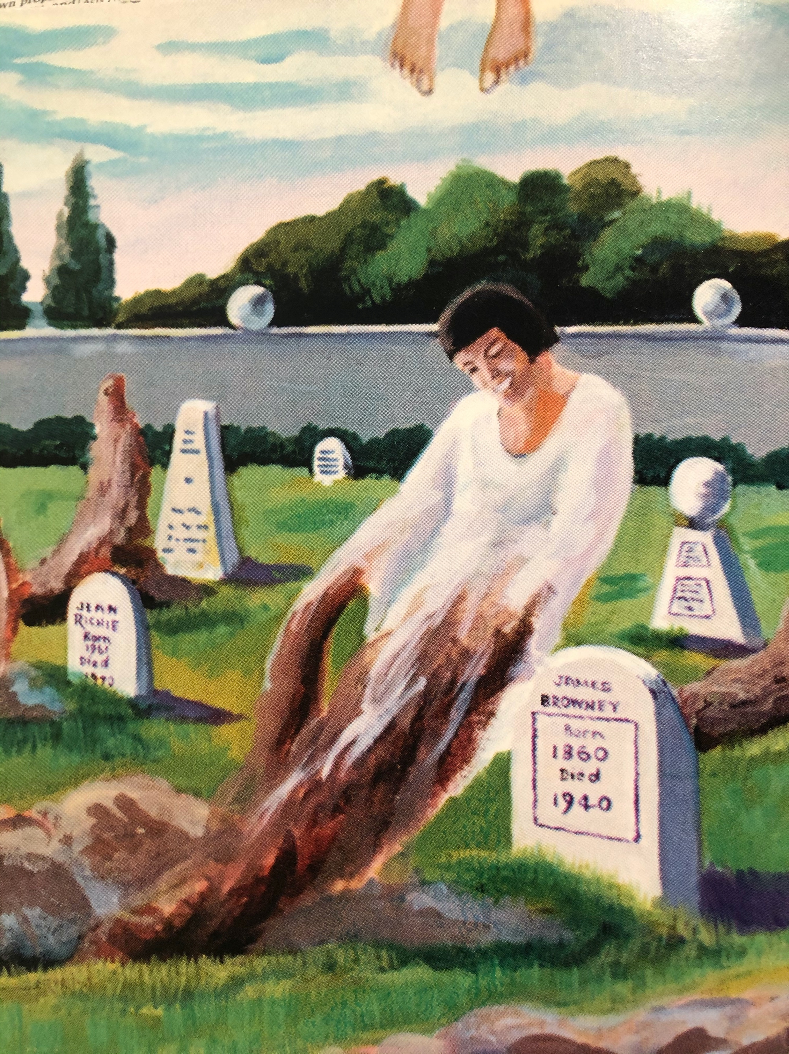
Rise Up
Call
  shout
    John 11:43
    Matthew 27:50
  voice
    Jude 9
  trump
    Revelation 1:10

Slide 9
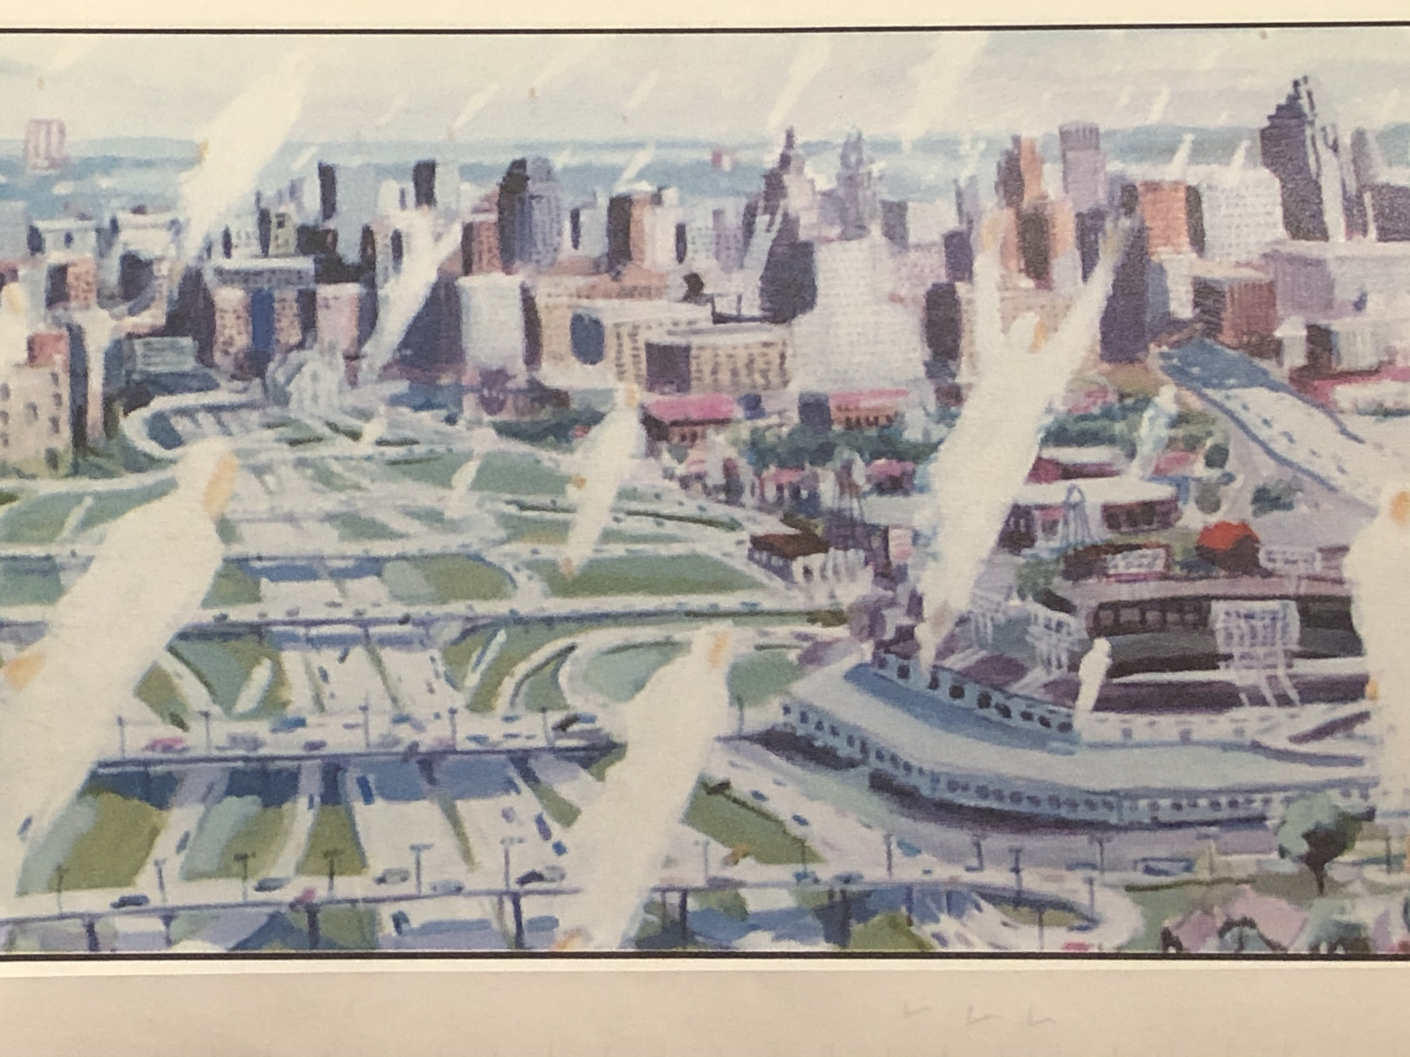
Rise Up
Caught up
  Phillip
  Paul
  Lord Jesus

Slide 10
Rise Up
Comfort
  Psalm 16:11
  John 14:1-3
  Hebrews 10:24-25

Slide 11
Cornerstone Bible Church
A Church desiring to help people find their purpose in life, expanding God’s kingdom through ministry.

