Slide 1
Welcome Back to Thessalonica
Cornerstone Bible Church
Pastor Duane Acree
01-10-2021

Slide 2
II Thessalonians 1:1-4
1 Paul, and Silvanus, and Timotheus, unto the church of the Thessalonians in God our Father and the Lord Jesus Christ:2 Grace unto you, and peace, from God our Father and the Lord Jesus Christ. 3 We are bound to thank God always for you, brethren, as it is meet, because that your faith groweth exceedingly, and the charity of every one of you all toward each other aboundeth;4 So that we ourselves glory in you in the churches of God for your patience and faith in all your persecutions and tribulations that ye endure:

Slide 3
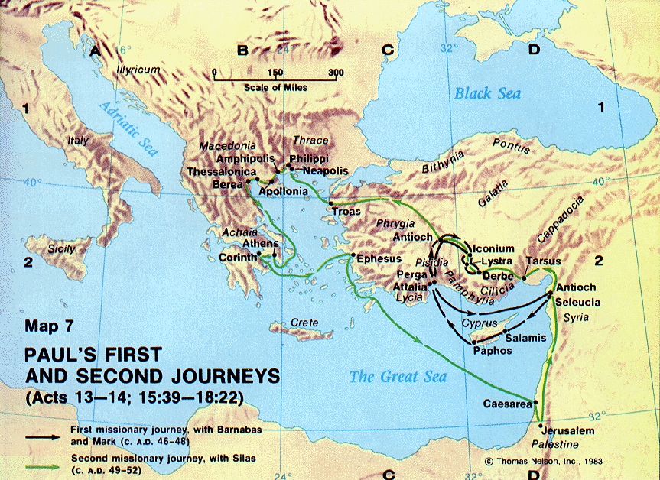

Slide 4
Welcome Back to Thessalonica
Crew
Church
Cause

Slide 5
Welcome Back to Thessalonica
Crew
  Paul apostle/evangelist
  Silas teacher
  Timothy pastor
  Ephesians 4:11

Slide 6
Welcome Back to Thessalonica
Church
  of the Thessalonians
  God our Father
  Lord Jesus Christ 84 x
    Lord Jesus Christ 20x
    Lordship Revelation 3:14-22

Slide 7
Welcome Back to Thessalonica
Cause
  faith (growing)
  charity (abounding)
  patience (enduring)
II Corinthians 8:1-5

Slide 8
Cornerstone Bible Church
A Church desiring to help people find their purpose in life, expanding God’s kingdom through ministry.

