Slide 1


The Queen’s Decision
Pastor Duane Acree

Slide 2

Esther 1:1-9
1 Now it came to pass in the days of Ahasuerus, (this is Ahasuerus which reigned, from India even unto Ethiopia, over an hundred and seven and twenty provinces:)2 That in those days, when the king Ahasuerus sat on the throne of his kingdom, which was in Shushan the palace,3 In the third year of his reign, he made a feast unto all his princes and his servants; the power of Persia and Media, the nobles and princes of the provinces, being before him:

Slide 3
Esther 1:1-9
4 When he shewed the riches of his glorious kingdom and the honour of his excellent majesty many days, even an hundred and fourscore days.5 And when these days were expired, the king made a feast unto all the people that were present in Shushan the palace, both unto great and small, seven days, in the court of the garden of the king's palace;

Slide 4
Esther 1:1-9
6 Where were white, green, and blue, hangings, fastened with cords of fine linen and purple to silver rings and pillars of marble: the beds were of gold and silver, upon a pavement of red, and blue, and white, and black, marble.7 And they gave them drink in vessels of gold, (the vessels being diverse one from another,) and royal wine in abundance, according to the state of the king.

Slide 5
Esther 1:1-9
8 And the drinking was according to the law; none did compel: for so the king had appointed to all the officers of his house, that they should do according to every man's pleasure.9 Also Vashti the queen made a feast for the women in the royal house which belonged to king Ahasuerus.

Slide 6
The Book of Esther
Reset
Reign
Reception

Slide 7
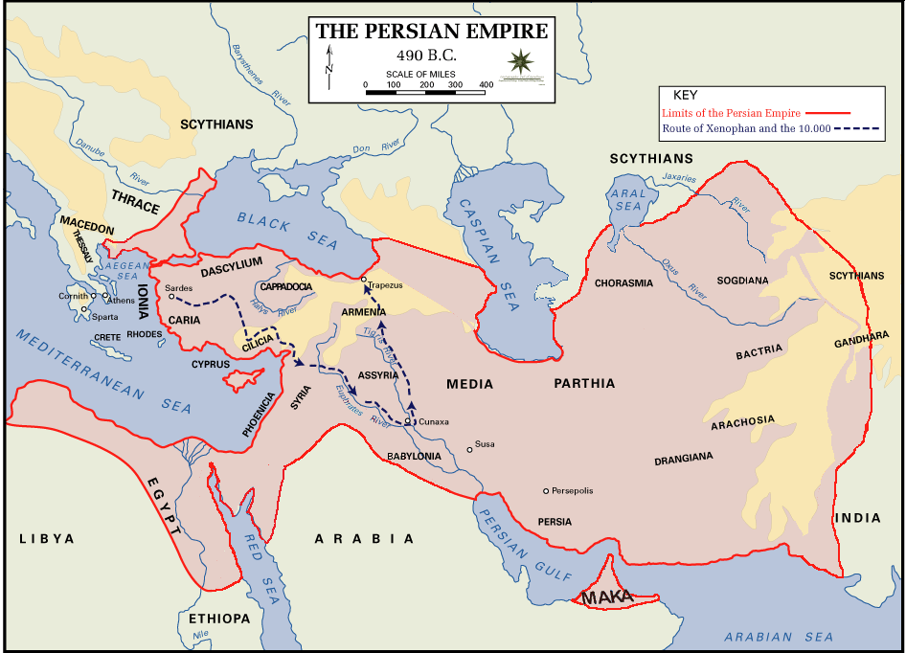
This Photo by Unknown Author is licensed under CC BY-SA

Slide 8
The Book of Esther
Reset
  Deuteronomy 31:16-18
  Ezra 1:1-3
  Isaiah 44:28
  Jeremiah 29:10
  providence of God

Slide 9
The Book of Esther
Reign
  485 – 465 B.C.
  title - Ahasuerus
  Khshayarsha,Akhashverosh,Xerxes
  Shusan, Susa
  473 B. C.
  12 years

Slide 10
The Book of Esther
Reception
  nobility Genesis 40:20
  others Daniel 5:1,28
  women Mark 6:21

Slide 11
A Church desiring to help people find their purpose in life, expanding God’s kingdom through ministry

